Slide 1

Electrifying Our Home
A personal journey
For our health, our budget and the planet!
Notes:
Why? Research has shown that electrification is the fastest way to reduce carbon emissions so what happens in households matters.

Slide 2
Why we electrified our home?
“Research has shown that electrification is the fastest way to reduce carbon emissions so what happens in households matters.
The electrification of our home began 3 years ago when we moved into an older style home that had gas cooktop, gas hot water, gas heating and older style wall inserted air conditioners.
Now we are 99% energy self-sufficient and save over $5,000 per year in energy and fuel costs.
This is the second house we have converted to totally electric – the first was 16 years ago, including an electric car.”
Notes:
Why? Research has shown that electrification is the fastest way to reduce carbon emissions so what happens in households matters.

Slide 3
Six Decisions to Electrify
    Solar Panels
    Home Battery
    Induction Cooktop
    Electric Heat Pump Hot Water System
    Reverse Cycle Heating and Cooling
    Electric Vehicle
Notes:
There are six items to Electrify

Slide 4
Making Plans to Electrify Your Household
Step 1: Know your daily and annual energy usage (gas and electric bills). Step 2: Note the age of gas appliances and vehicles and their energy use (check manuals and online). Step 3: Choose your future needs for electric appliances and vehicles. Step 4: Prioritise the order of replacing your appliances and vehicle. Consider... Replacing gas cooktop, oven and space heating to improve indoor air quality. Replacing appliances more than 10 years of age, to fast track the transition to an all-electric home.
Current Appliance | Current Age of your Appliance | Go Electric with a …… (*Most efficient appliance) | Time frame for when could I replace
Gas cooktop |  | ☐ Induction cooktop* ☐ Electric stove
Gas oven |  | ☐ Electric Oven
Gas space heating |  | ☐ Reverse cycle air conditioning
Gas hot water |  | ☐ Electric heat pump*
Petrol or diesel cars |  | ☐ Electric vehicle ☐ Electric bike or scooter
Gas swimming pool heating |  | ☐ Solar heating ☐ Electric (air source) Heat pump

Slide 5
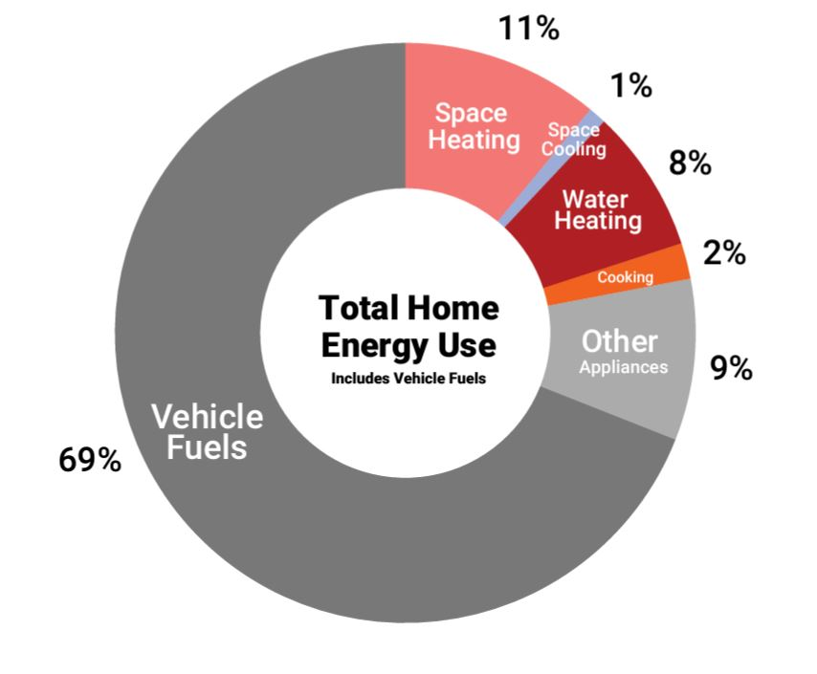
Appliance and Household Energy Use %
Pie graph from rewiringaustralia.org
“The main reason we wanted to electrify our home was to reduce our carbon emissions.
As you can see from the pie-graph, Australia-wide, the big three energy consumers are… household vehicles, house heating and heating water.”

Slide 6
Solar Panels
“Our first step was the installation of our rooftop solar panels and a home battery to ensure our energy supply was from renewable energy and protect us from any power outages.”
8kW rooftop solar with 20kW home battery.
The panels went on NW and SW roof orientation.
Old panels were recycled wasolarrecycling.com.au (located in Wattle Grove WA)
Energy output is 20kWh per day (winter) - 60kWh per day (summer)
Notes:
Our first step was the installation of our rooftop solar panels and a home battery.
8kW Rooftop Solar
The panels went on the NW and SW roof orientation
Ranges between 20kWh and up to 60kWh per day

Slide 7
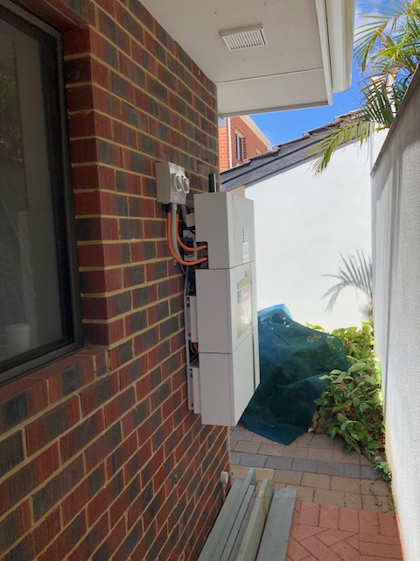
Our Home Battery
Notes:
10kW Home Battery

Slide 8
Home Batteries
  Charge using solar or off-peak tariff
  Add to new or existing solar panels
  Synergy Midday Saver – only 8 cents/kWh –
  If not full using solar then charge from grid 1pm to 3pm
  Possible to have battery with no solar panels
  Connected to the (VPP)Virtual Power Plant
  State and Federal Rebates
Notes:
By doing this we are able to use the Synergy Midday Saver –
Buy at 8 cents/kwh during the day to fill the battery up by 3pm. So, we draw from the battery instead of the grid during the evening peak.
Compare this to the Standard rate of 32 cents/kwh
We decided to be part of the Virtual Power Plant. When Synergy is running short in the evening peak they draw from our battery (30%).
We get paid by Synergy 90cents/kwh
Full Purchase Price of panels and battery was $17,876
Less STCs $ 3,376
Total Purchase Price including GST $14,500

Slide 9
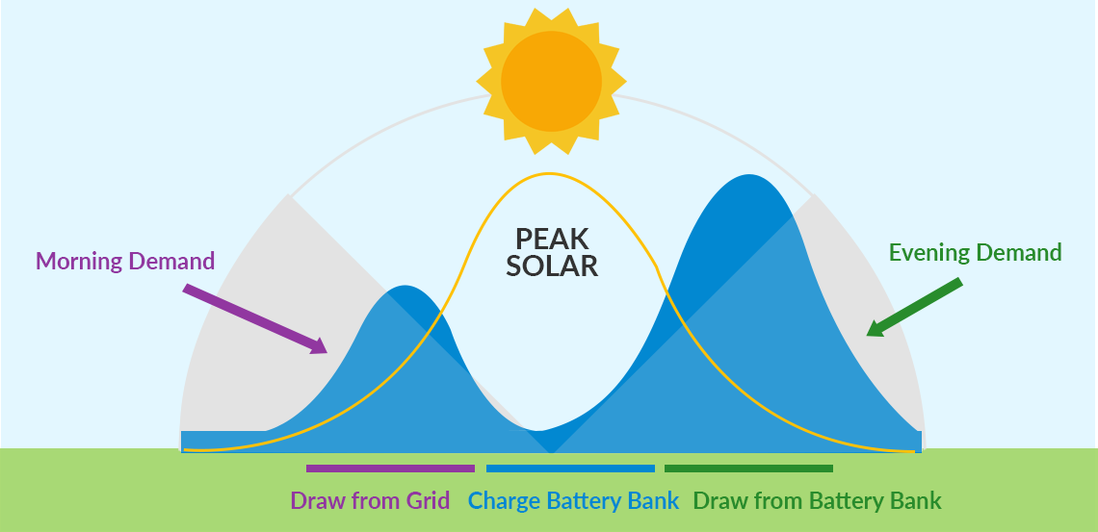
There is excess solar in the middle of the day
“This graphic shows that having Solar and Battery helps stabilize the grid and is part of the reason why Synergy has the Midday Saver at 8 cents/kWh (9am to 3pm) to encourage the use of excess solar exported to the grid.
We can charge our battery on solar or draw from the grid.”

Slide 10
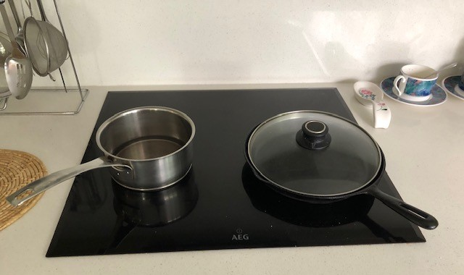
Our Induction Cooktop
Notes:
60cm x 60cm induction cooktop - works well for 5 people
love the timer which means we can put rice on top cook and go for a walk
Be aware that not all induction cooktops have a built-in timer that turns off each section individually
less heat loss to the air so it means a cooler kitchen in summer
Easy to wipe clean
Needs a separate electrical circuit when installed
And there are induction compatible woks.
Choice Magazine recommended the Ikea Portable Induction Cooktop. Good for renters and if people want to trial $50 - $44.10 up until the 24th March at Ikea

Slide 11
Induction Cooktops
“We chose a 60cm x 60cm induction cooktop which works well for 5 people.
We love the timer which means it turns off automatically.
But not all induction cooktops have a built-in timer that turns off each section individually.
We use an induction compatible wok to cook stir-fry.”
  Twice as efficient as gas cooktop
  Heats faster than gas and has instant heat control
  Better air quality. No Nitrous Oxide.
  Less heat loss to the air so a cooler kitchen
  Easy to clean and many have inbuilt timers
  Ikea Portable Induction Cooktop. Good for renters and if people want to trial. Costs about $50.

Slide 12
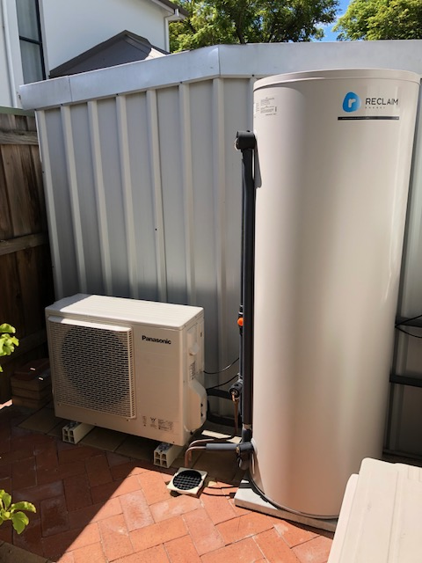
Our Electric Heat Pump Hot Water System

Slide 13
Our Electric Heat Pump Hot Water System
“We had a gas hot water system which cost about $700/year to run.
Now our hot water system is timed to run from our solar energy.
Our heat pump uses about 2kwh per day from our solar
Heat Pumps work similar to reverse cycle air conditioning.
They extract heat from the atmosphere and the captured heat in the refrigerant is compressed to increase the temperature and then transferred to the water in the tank.
We had previously used Heat Pump Hot water for over 15 years
and never ran out of hot water with 5 people and a 315-litre tank.
Because of the “hard water” in Perth they no longer sell stainless steel tanks
but are now glass lined.
Our Reclaim has a stand-alone compressor but some have a compressor built in.
We took care with the location and noise considerations
(no more noise than an air conditioner)”

Slide 14
Electric Heat Pump Hot Water Systems
  3-5 times more energy efficient
  Works similar to Reverse Cycle Air-conditioning
  Refrigerant boils at low ambient temperatures
  Built in timers maximise rooftop solar & off-peak
  RESEARCH BEFORE YOUR OLD SYSTEM NEEDS REPLACING.

Slide 15
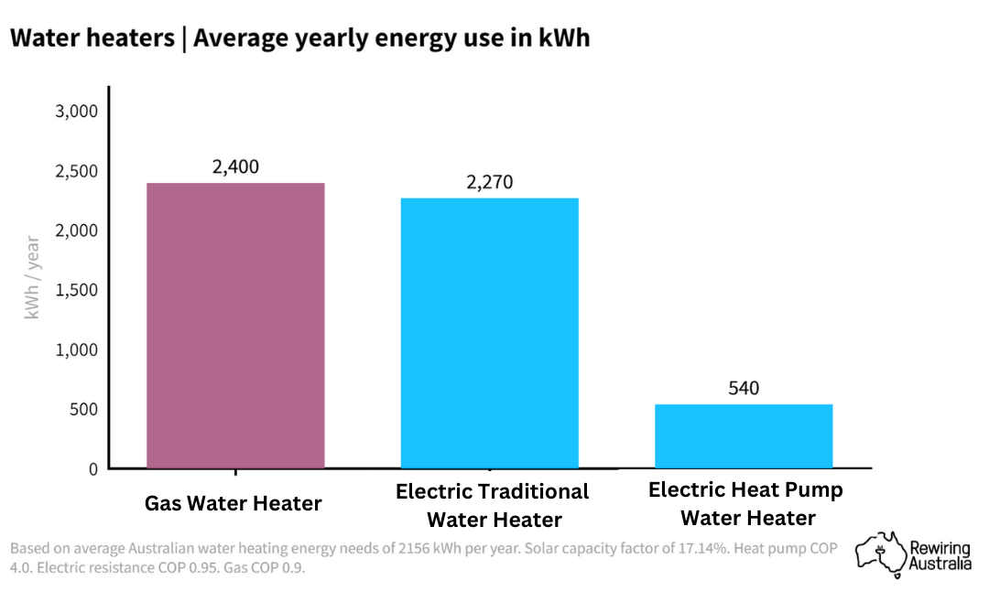
Comparison of Energy Use of Hot Water Systems

Slide 16
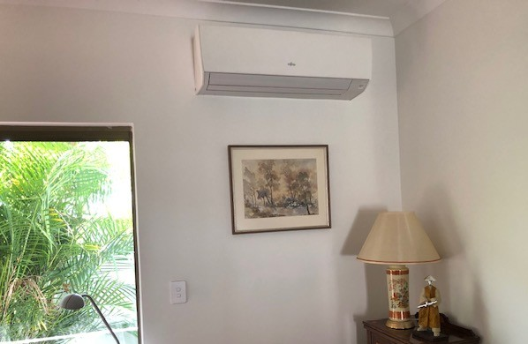
Our Reverse Cycle Heating and Cooling

Slide 17
Reverse Cycle Heating and Cooling
Uses 3-4 times less energy than gas heating.
Individual Units are cheaper to run than ducted.
Set at 19 degrees in winter
Set at 24 degrees in summer
One degree up/down impacts consumption by 10%

Slide 18
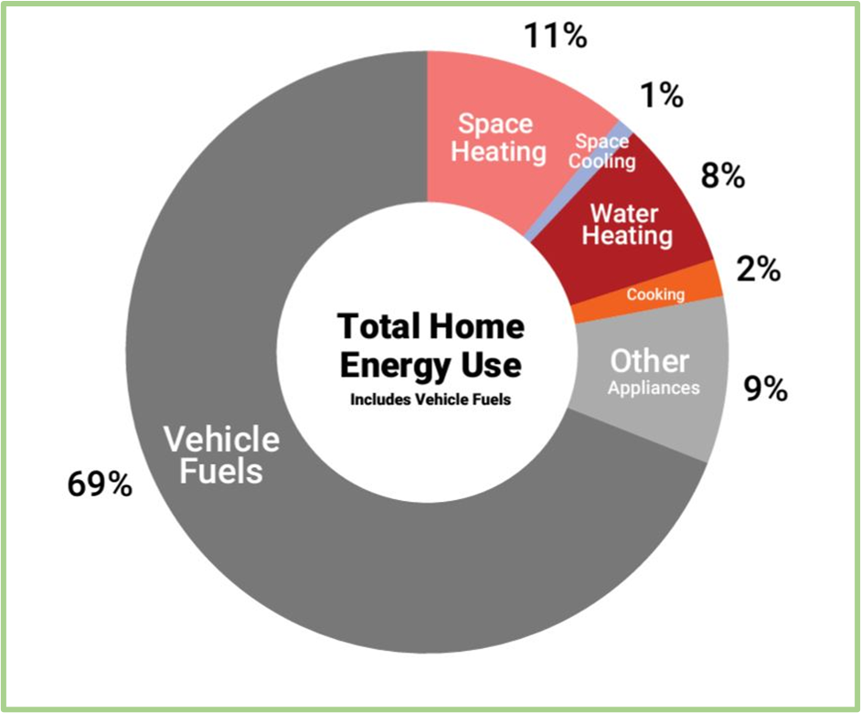
69% of Total Energy Use is from Household Vehicles
Pie graph from rewiringaustralia.org

Slide 19
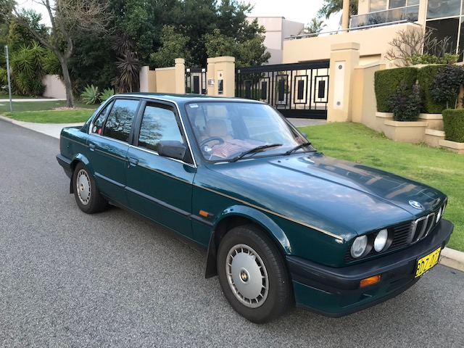
Our First Electric Car 2010
“We realized that a car produces nearly 70% of a household’s emissions.
In 2010 there were no commercial electric vehicles available so we had a 1990 BMW 318i which was in good condition car converted to electric by EV Works.
We have saved the cost of the conversion in fuel savings over ten years.
We drove 12,000 km/yr for 10 years and sold it in 2020 with still 2/3 of the original battery capacity.
Bought the Hyundai 100% Electric Kona in 2020
which can do about 500km on a single charge.”

Slide 20
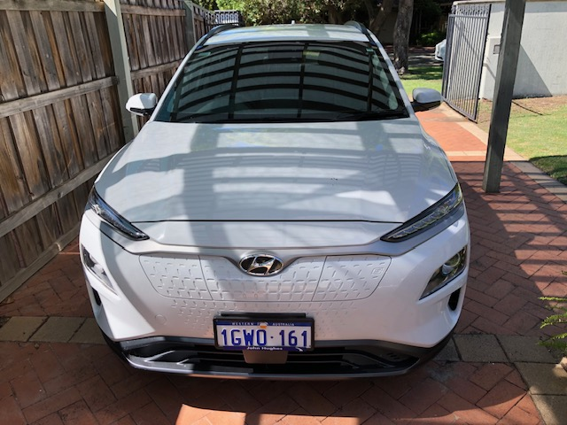
Our Current Electric Car

Slide 21
Electric Vehicles
EVs convert 77% of electricity into power
Fossil Fuel vehicles convert 12-30% into power.
Require less servicing and more reliable because there are fewer moving parts.
Resilient against high petrol prices!!
Maximise your solar by charging the car at home

Slide 22
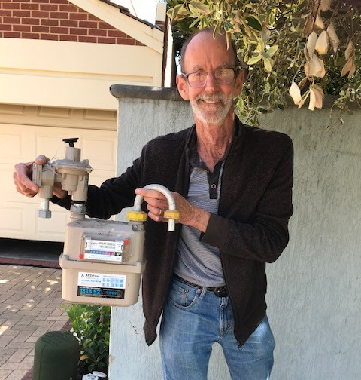
Gas Meter Finally Removed!
We now have Electrified Everything!

Slide 23
What do YOU want to do next
on your Journey to Net Zero?
The End

